Slide 1
SEXUAL AROUSAL DISORDER: PORNOGRAPHY
Robert Melashenko MD

Slide 2
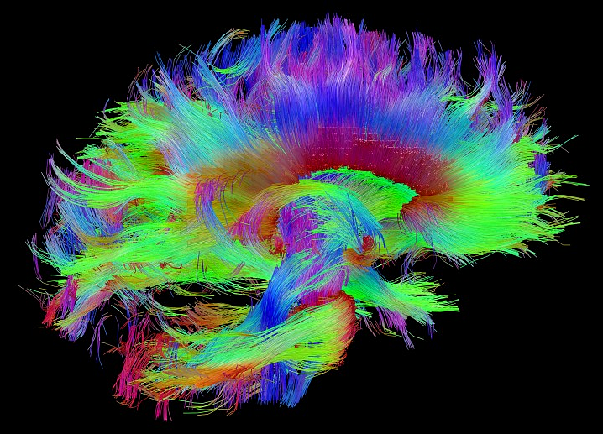
http://www.humanconnectomeproject.org/gallery/

Slide 3
Disclosure. God’s original plan for marriage:
And he answered and said unto them, Have ye not read, that he which made them at the beginning made them male and female, And said, For this cause shall a man leave father and mother, and shall cleave to his wife: and they twain shall be one flesh? Wherefore they are no more twain, but one flesh. What therefore God hath joined together, let not man put asunder.
(Matthew 19:4-6 KJV) -Underlining added

Slide 4
ADDICTION
Loss of control of the behavior.
Compulsively seeking out despite negative consequences.
Tolerance—needing higher and higher levels of stimulation for satisfaction.
Withdrawal.

Slide 5
Natural Addictions
Pathological overeating.
Gambling.
Sexual addictions.

Slide 6
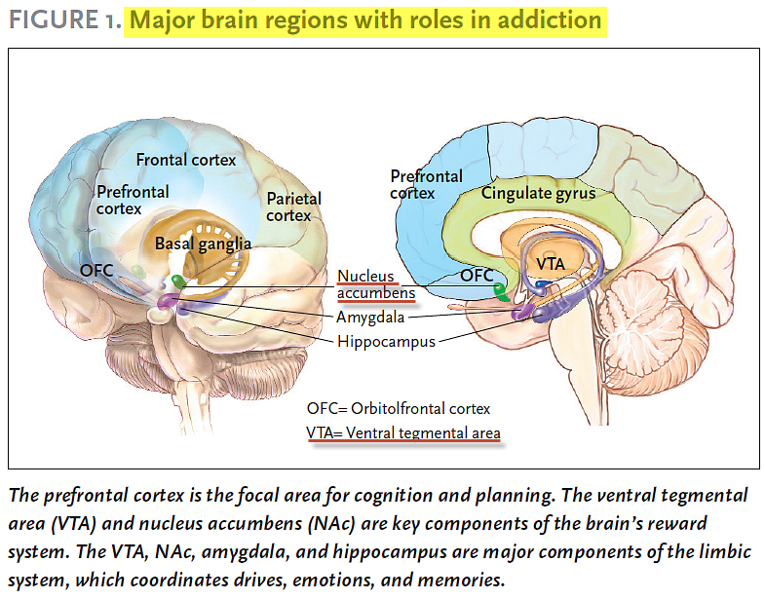
SCIENCE & PRACTICE PERSPECTIVES — APRIL 2007

Slide 7
“A single dose of many addictive drugs will produce a protein, called Delta-FosB…….that accumulates in the neurons. Each time the drug is used, more Delta-FosB accumulates, until it throws a genetic switch, affecting which genes are turned on and off. Flipping this switch causes changes that persist long after the drug is stopped, leading to irreversible damage to the brain’s dopamine system and rendering the animal far more prone to addiction.”
(The Brain That Changes Itself; Norman Doidge, MD., P107) -Bold added

Slide 8
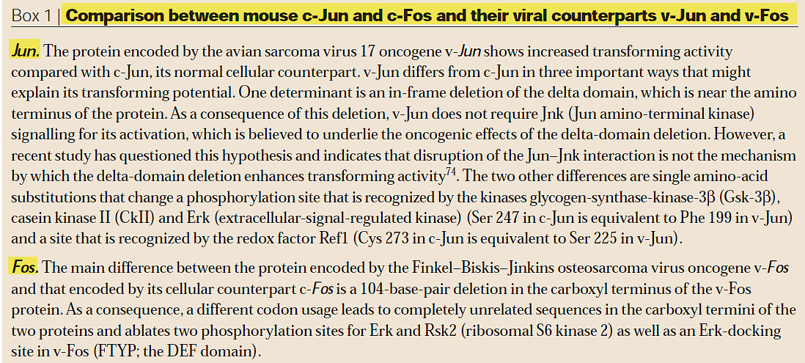
c-Jun & c-Fos are retroviral
NATURE REVIEWS CANCER. VOL. 3 NOVEMBER 2003

Slide 9
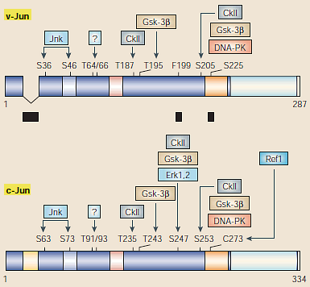
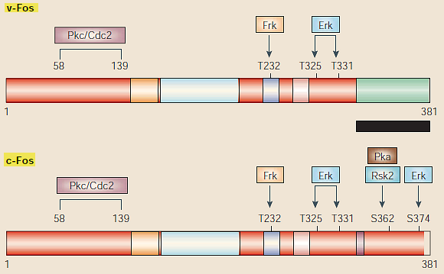
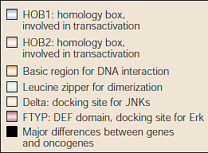
Comparison between cellular & viral Jun/Fos
NATURE REVIEWS CANCER. VOL. 3 NOVEMBER 2003

Slide 10
Studies have shown that blocking delta-Fos B stops addictive behavior, drug or sexual, from forming in virgin rats—and abolishes the behavior in addicted animals. Consequently, it is necessary for both induction and perpetuation of the addictive state.
Pitchers KK, et al. DFosB in the nucleus accumbens is critical for reinforcing effects of sexual reward. Genes Brain Behav. 2010;9:831–40.

Slide 11
Viewing porn activates the same neuronal pathways in the Reward Center as:
Methamphetamine.
Cocaine.
Heroin.
This neural circuit differs from other “Natural Addiction” circuits tying into the Reward Center such as eating food high in sugar and fat, and gambling—and explains why these drugs are often associated with sex; and consequently why sexual addictions are often very difficult to treat.

Slide 12
Porn addiction cause changes in the brain itself:
The Frontal and Pre-frontal areas, or “self-control” center, of the brain atrophy decreasing the ability to resist further porn behavior. This is called “hypo-frontal syndrome”.
Decreases in Dopamine receptor density in the Reward Center can occur which induces a profound state of reward hypofunction, and triggers the emergence of compulsive like porn seeking behaviors” and ever stronger porn “novel” and “shocking” stimuli.
The “Coolidge Affect” leads to behavior such as “web surfing” where the individual rapidly switches from scene to scene to scene in order to increase novelty.

Slide 13
In 2014, in a study conducted at the Max Planck Institute for Human Development in Berlin, 64 healthy male adults, all with a wide range of pornography consumption, reported hours of porn consumption per week. Grey matter volume in the brains of each subject were then measured using MRI technology. Researchers found a significant negative correlation: the more hours of pornography consumed, the smaller volume of grey matter in the right caudate, and the less functional connectivity between the striatum and the left dorsolateral prefrontal cortex. Researchers hypothesize that because of the intense stimulation of the brain’s reward system through pornography, this can bring about significant changes in the brain similar to what is seen in drug addictions.

Slide 14
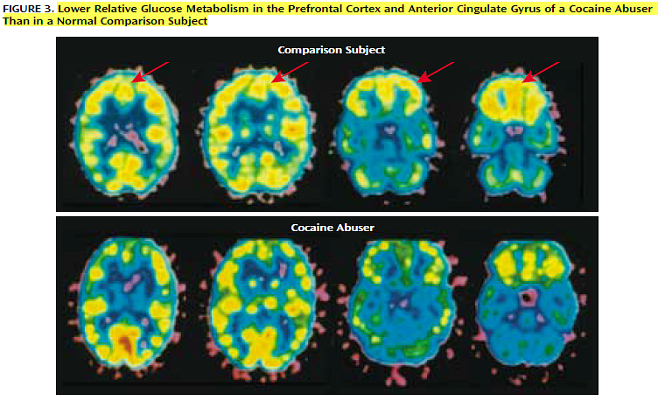
Am J Psychiatry 159:10, October 2002

Slide 15
Dr. Nestler summarizes: “These findings suggest that ΔFosB in this brain region sensitizes animals not only for drug rewards but for natural rewards as well, and may contribute to a state of natural addiction.”
Nature Neurosci. 2005;9:1445–9

Slide 16
When the unclean spirit has gone out of a man, he walks through dry places seeking rest. And finding none, he says, I will return to my house from which I came out. And when he comes, he finds it swept and decorated. And he goes and takes seven other spirits more wicked than himself, and entering in, they dwell there. And the last state of that man is worse than the first.
(Luke 11:24-26 MKJV)

Slide 17
“Softcore pornography’s influence is now most profound because, now that it is no longer hidden, it influences young people with little sexual experience and especially plastic minds, in the process of forming their sexual tastes and desires. Yet the plastic influence of pornography on adults can also be profound, and those who use it have no sense of the extent to which their brains are reshaped by it”
(The Brain that Changes Itself; Norman Doidge MD., page 103)-Bold added.

Slide 18
Dearly beloved, I beseech you as strangers and pilgrims, abstain from fleshly lusts, which war against the soul;
(1Pe 2:11)

Slide 19
"Those who see you will gaze at you, And consider you, saying: 'Is this the man who made the earth tremble, Who shook kingdoms, Who made the world as a wilderness And destroyed its cities, Who did not open the house of his prisoners?‘ (Isa 14:16-17)
"I, the LORD, have called You in righteousness, And will hold Your hand; I will keep You and give You as a covenant to the people, As a light to the Gentiles, To open blind eyes, To bring out prisoners from the prison, Those who sit in darkness from the prison house. (Isa 42:6-7)

Slide 20
The journal NeuroImage published a study in 2008 demonstrating that as men are sexually aroused by pornography, the mirror neurons in the brain also fire. This means the brain naturally imagines the porn viewer in the scene. The man is not merely responding to the naked woman. His brain is mirroring the pornographic scene with the viewer as the main character, heightening arousal.
But I say unto you, That whosoever looketh on a woman to lust after her hath committed adultery with her already in his heart.
(Matthew 5:28 KJV)

Slide 21
And that they may recover themselves out of the snare of the devil, who are taken captive by him at his will.
(2Ti 2:26)

Slide 22
HOW PERVASIVE IS PORN?

Slide 23
According to a survey conducted by the Barna Group in the U.S. in 2014:
The following percentages of men say they view pornography at least once a month: 18-30-year-olds, 79%; 31-49-year-olds, 67%; 50-68-year-olds, 49%
The following percentages of men say they view pornography at least several times a week: 18-30-year-olds, 63%; 31-49-year-olds, 38%; 50-68-year-olds, 25%
The following percentages of women say they view pornography at least once a month: 18-30-year-olds, 76%; 31-49-year-olds, 16%; 50-68-year-olds, 4%
The following percentages of women say they view pornography at least several times a week: 18-30-year-olds, 21%; 31-49-year-olds, 5%; 50-68-year-olds, 0%

Slide 24
Christians and Porn
39% of Christian men and 13% of Christian women say they believe their use of pornography is “excessive” (compared to 19% of non-Christian men and 12% of non-Christian women).
21% of Christian men and 2% of Christian women say they think they might be “addicted” to pornography or aren’t sure if they are (compared to 10% of non-Christian men and 4% of non-Christian women).

Slide 25
Porn and Marriage
According to sociologist Jill Manning, the research indicates pornography consumption is associated with the following six trends, among others:
Increased marital distress, and risk of separation and divorce.
Decreased marital intimacy and sexual satisfaction.
Infidelity.
Increased appetite for more graphic types of pornography and sexual activity associated with abusive, illegal or unsafe practices.
Devaluation of monogamy, marriage and child rearing.
An increasing number of people struggling with compulsive and addictive sexual behavior leading to psychological distress and even loss of employment.

Slide 26
“The net had, in other words, revealed to me that I had an unquantifiable variety of sexual fantasies and quirks and that the process of satisfying these desires online only led to more interest”…………
Thomas’s experience was similar to that of my patients: without being fully aware of what they were looking for, they scanned hundreds of images and scenarios until they hit an image or sexual script that touched some buried theme that really excited them………
Once Thomas found that image, he changed………Now Thomas was hooked”. (The Brain That Changes Itself: Norman Doidge MD., p. 117)

Slide 27
A rising performer, Amy Brooke, entered the adult business in 2009, and has already garnered the AVN award for “most outrageous sex scene.” With over 200 films under her belt, Brooke is aware of the chances she takes dedicating herself to her fans’ entertainment. “Your body can’t take doing that every single day—it might break or start prolapsing.” Strenuous scenes can take a toll on the body over time, thus limiting a career to a certain number of years. Sensitive flesh is pounded raw, and muscles are stretched to their limits. In this line of work a girl cannot work every day; she needs “recovery” days. Fortunately I’ve been lucky, but I know others who have been injured from the same sorts of scenes. It’s a high-risk, high-dollar job. (Blood, Sweat and Sex: My Hard Life in Porn; Aurora Snow, The Daily Beast, March 18,2013)

Slide 28
Collateral Damage
In a survey of 63 wives of self-identified sex addicts:
70% met most criteria for a diagnosis of post-traumatic stress disorder.
75% discovered evidence of compulsive or addictive sexual behaviors themselves (as opposed to a planned disclosure on the part of a husband).
71% demonstrated a severe level of functional impairment in major areas of their lives.
Length of marriage at disclosure and number of prior traumatic event exposures were the best predictors increased trauma symptoms.

Slide 29
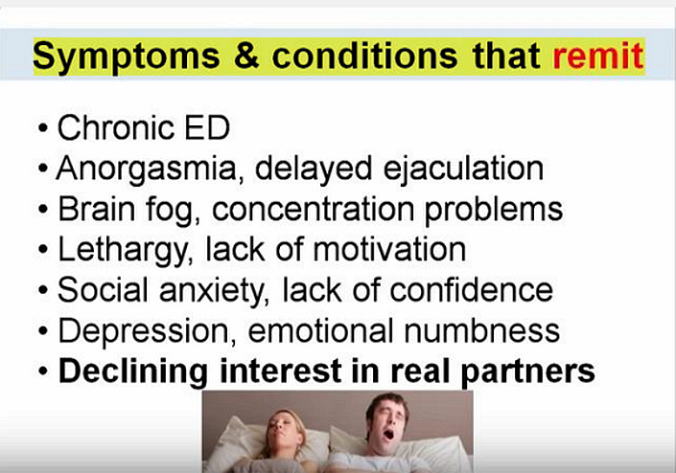

Slide 30


Slide 34
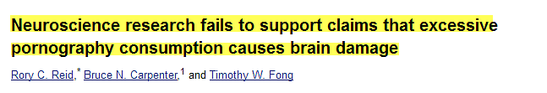

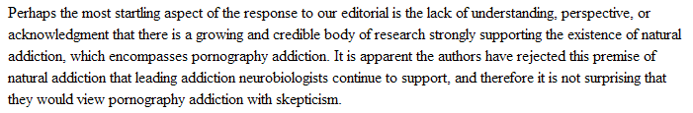
Surg Neurol Int. 2011; 2: 64

